Slide 1







BUILD
WITH
भारत 2.0
N A T I O N A L L E V E L H A C K A T H O N
T E A M N A M E : Rescue Mesh
P R O B L E M S T A T E M E N T : Autonomous Post-Disaster Survivor Localization and Resilient Mesh Communication in Zero-Infrastructure Collapse Zones.
T E A M M E M B E R S : 1. M Shamvas Raja 2. K Lokeshwaran 3. S Priya Dharshan
4. M Nithish Kumar 5. N S Geethalaxmi
C O L L E G E : CHENNAI INSTITUTE OF TECHNOLOGY
भा र त 2 . 0

Slide 2

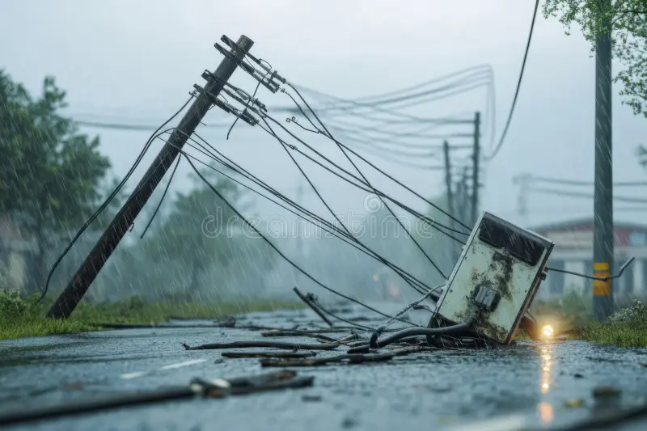
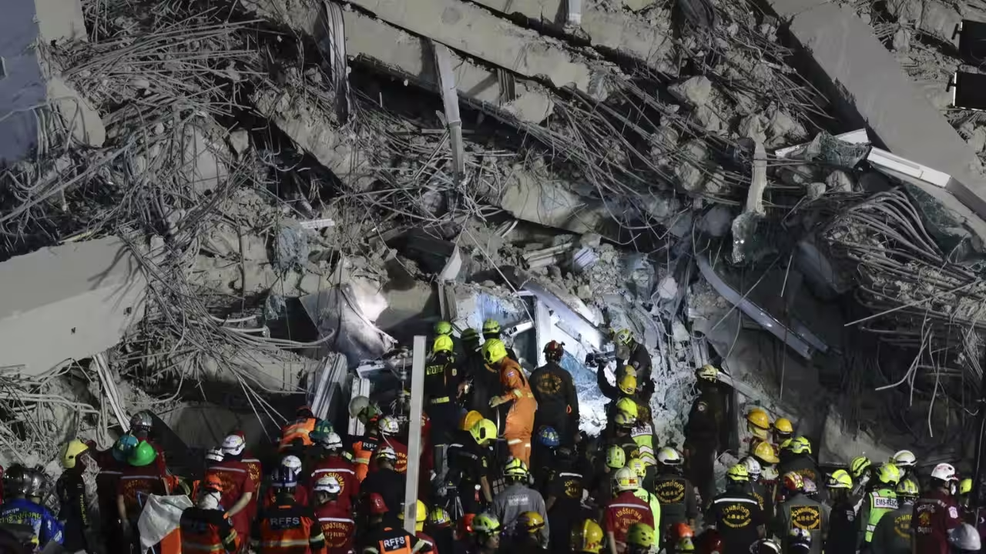
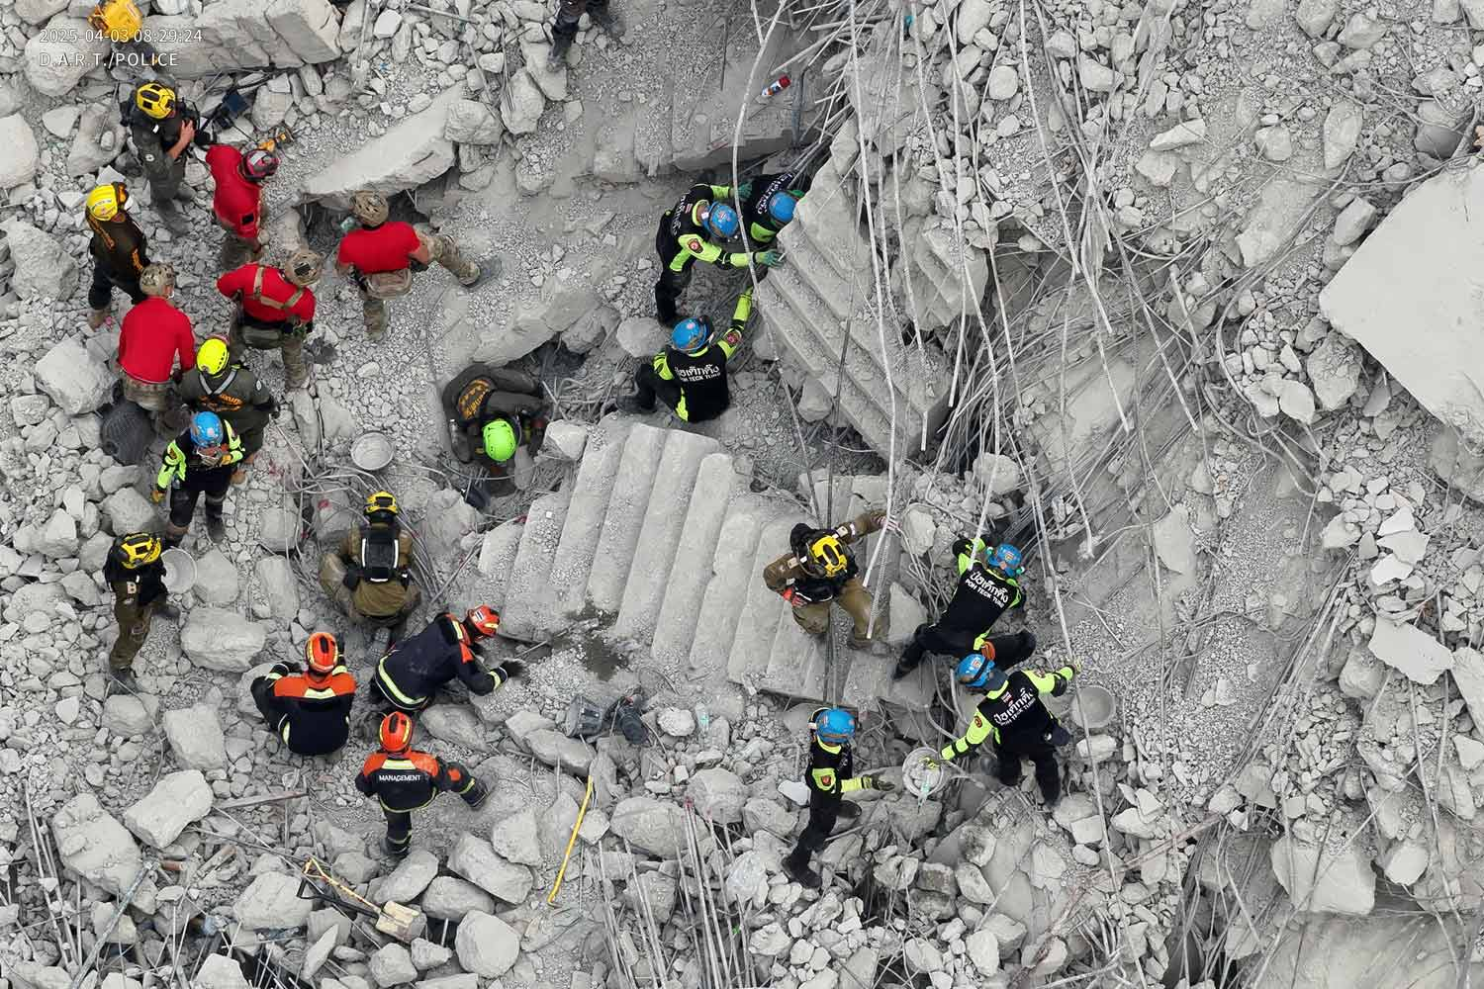
PROBLEM STATEMENT
Infrastructure Blackout
Detection Latency
Rescuer Risk & Blind Entry
Severe natural disasters instantly destroy local cellular towers, power grids, and terrestrial networks, plunging the entire disaster zone into a total communication blackout. This sudden loss of connectivity leaves ground rescue teams cut off from field coordination and command base stations.
Locating trapped victims under dense concrete rubble using manual search techniques or K9 units is painstakingly slow and labour intensive. Because of these delays, trapped survivors often exceed the critical 72-hour survival window before rescue teams can pinpoint their location.
First responders are forced to enter unstable, debris-heavy collapse zones blindly without any prior structural safety data or survivor telemetry. Operating without localized situational awareness exposes rescue personnel to severe aftershock hazards, toxic voids, and secondary collapse risks.
भा र त 2 . 0

Slide 3
SOLUTION
Autonomous Survivor Detection & Communication Network
Rescue-Mesh deploys compact, low-cost smart sensor beacons across disaster-hit environments to restore local connectivity and locate trapped survivors beneath heavy debris. The beacons instantly form an ad-hoc, self-healing mesh network without relying on cellular towers or external power infrastructure. Using integrated acoustic and vibration sensors, each node continuously monitors for human distress signals—such as cries for help, knocking, or movement—and runs edge-level signal filtering to validate real survivors. Once detected, the system transmits precise GPS coordinates and emergency triage alerts across the multi-hop network to a centralized command dashboard and mobile applications for first responders.
Key Features
Instant Self-Healing Mesh: Automatically discovers neighbour nodes and routes telemetry packets across multi-hop paths even if intermediate nodes fail.
Dual-Sensor Edge Detection: Fuses MEMS acoustic listening with piezo-vibration sensing to detect trapped victims while filtering out ambient debris noise.
Deep Rubble Penetration: Employs sub-GHz LoRa RF transmission to carry critical survivor data through collapsed concrete and subterranean voids.
Swarm & Drone Deployable: Lightweight, battery-backed beacon form factor optimized for rapid ground scattering or remote aerial payload drops.
Real-Time Rescuer Dashboard: Delivers live survivor mapping, GPS location pins, and triage priority levels directly to field rescue teams.
भा र त 2 . 0

Slide 4
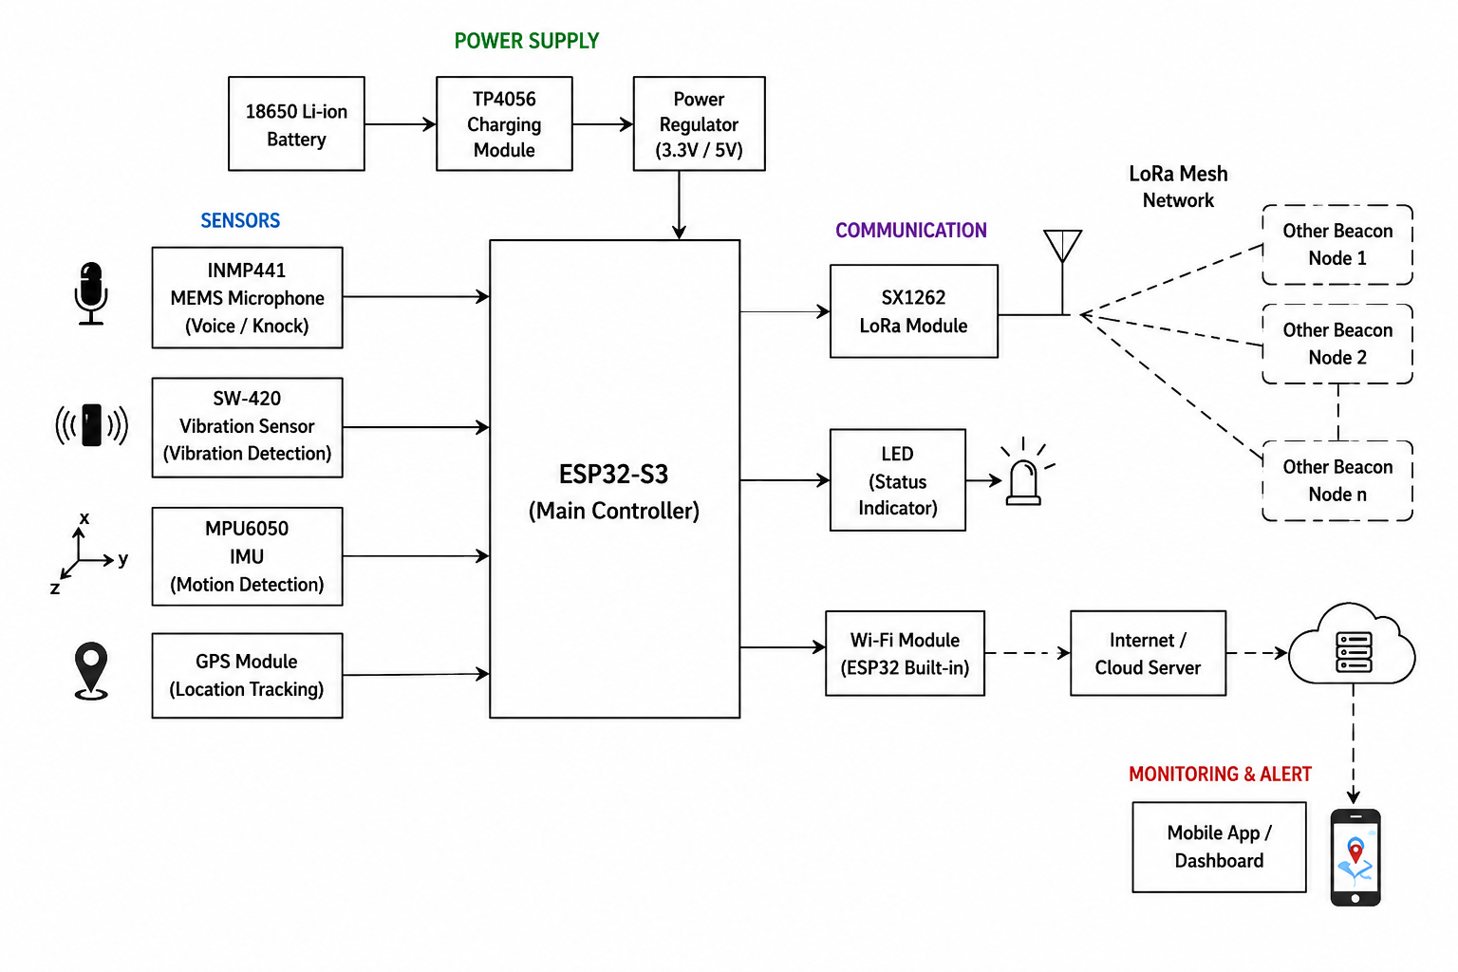
FLOW OF SOLUTION
भा र त 2 . 0

Slide 5
TECH STACK
Hardware
Software
Communication
ESP32-S3
SX1262 LoRa Module
INMP441 Microphone
SW-420
MPU6050
GPS Module
18650 Li-ion Battery + TP4056 Charger
Onboard Status LEDs
Micro Python / Arduino Firmware
Real-time Signal Processing
ML-based Survivor Detection
Mobile App
GPS Processing Libraries (Tiny GPS++)
Painless Mesh (Mesh Networking Protocol)
LoRa Long-Range Communication Protocol
Emergency Command Centre Web Dashboard
भा र त 2 . 0

Slide 6

UNIQUE SELLING PROPOSITION (USP)
Zero Infrastructure
Low-Cost Swarm
Edge-AI Detection
Deep Penetration
Real-Time Triage
Drone-Deployable
WHY RESCUE MESH
भा र त 2 . 0

Slide 7
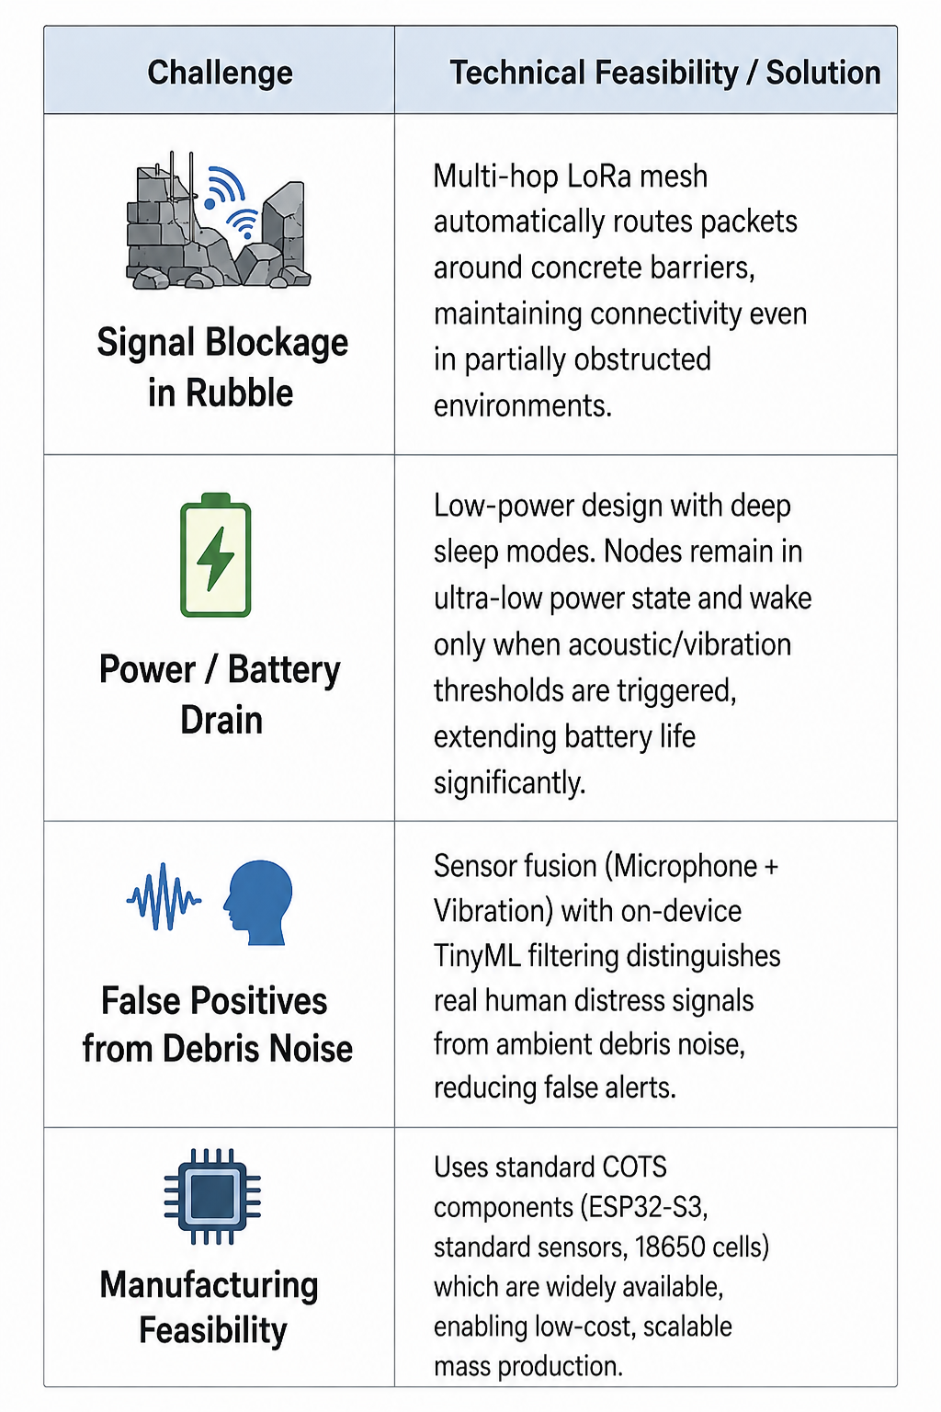
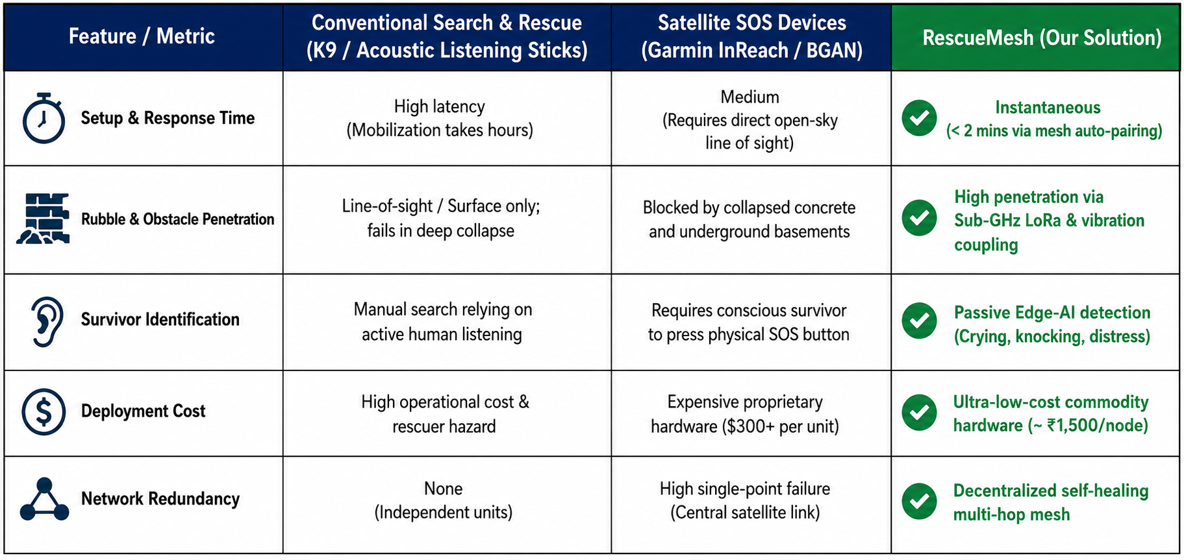
FEASIBILITY & COMPETITORS
भा र त 2 . 0

Slide 8
RESEARCH & REFERENCE
Author(s) | Published year | Reference / Source | Link | Core Concepts Implemented in Rescue Mesh
López-Villegas et al | 2026 | A Systematic Literature Review of Emergency Communications Assisted by UAVs | Link | Multi-Hop WSN Routing: Adopted multi-hop ad-hoc network topologies and optimization algorithms for drone-assisted disaster zones.
Alsamhi et al | 2022 | UAV Computing-Assisted SAR Mission Framework for Disaster Mitigation (MDPI Drones) | Link | Edge Intelligence in SAR: Implemented edge computing models on nodes to process local acoustic sensor data before relaying.
Manuel, Faied & Krishnan | 2024 | A LoRa-Based Disaster Management System for SAR Missions (IEEE IoT Journal) | Link | Decentralized LoRa LPWAN: Applied long-range sub-GHz packet routing for zero-cellular disaster communications.
NDMA Guidelines | 2023 | National Disaster Management Guidelines for Emergency Telecommunications | Link | Triage & Emergency Framework: Aligned triage severity metrics, golden-hour alert urgency, and field team dispatch protocols.
भा र त 2 . 0

Slide 9
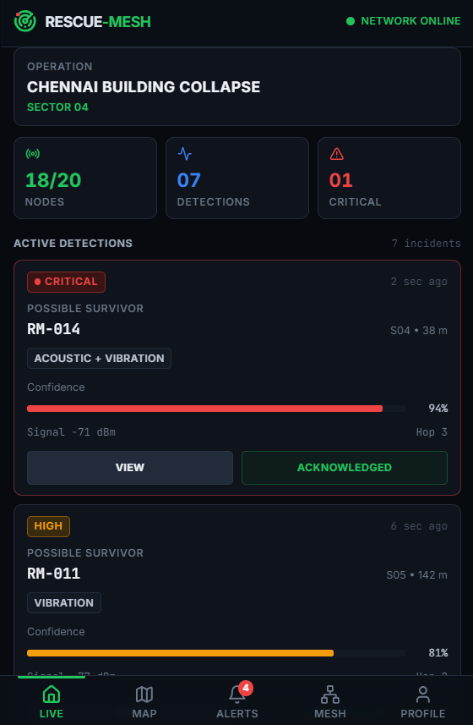
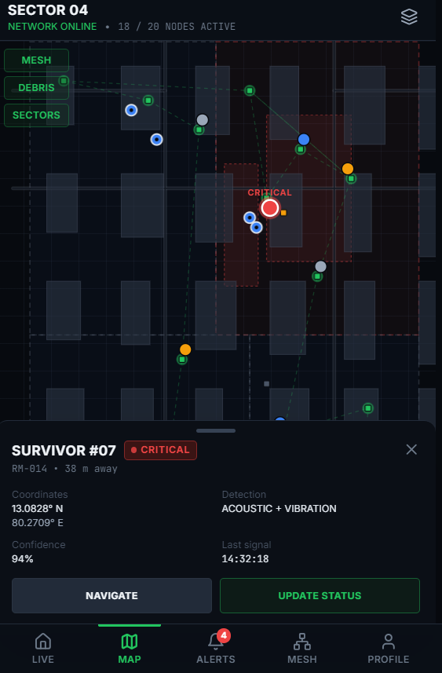
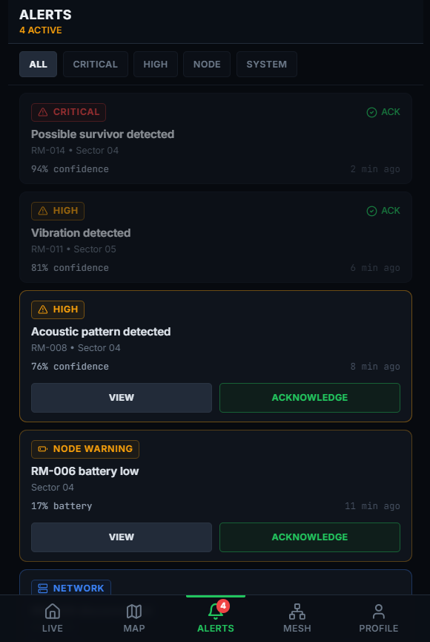
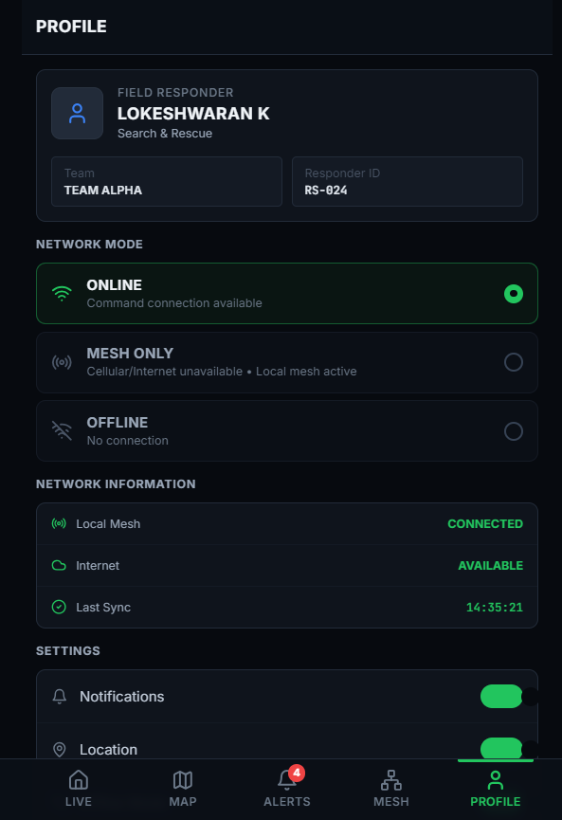
MOBILE APP DASHBOARD
भा र त 2 . 0

